Slide 1
EC311 Final Project
Puck
Vikram Singh Bhalla, Michael Daniels,
Junseo Lee, Prashast Pandey

Slide 2
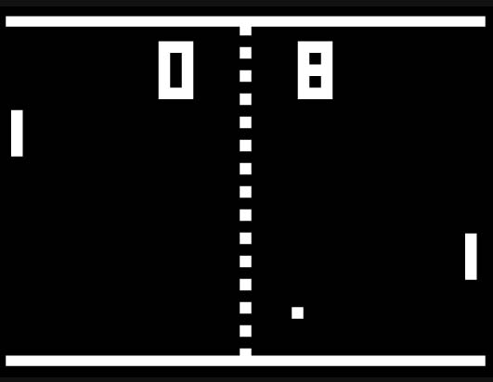
Goal // Motivation
Making a Single player game using Verilog and VGA
Motivated from Pong
Algorithm can be applied in collision detection systems

Slide 3
Functionality
01
Single controllable paddle
03
Two player
Two paddles
02
Volley the puck between paddle and wall
04
Once the puck goes past the paddle
Increases score
Game over
Notes:
Explain what design is supposed to do

Slide 4
Specifications
Pixel Generation
Debouncer
Button Input
VGA Controller
Puck Generation
Top Module

Slide 5
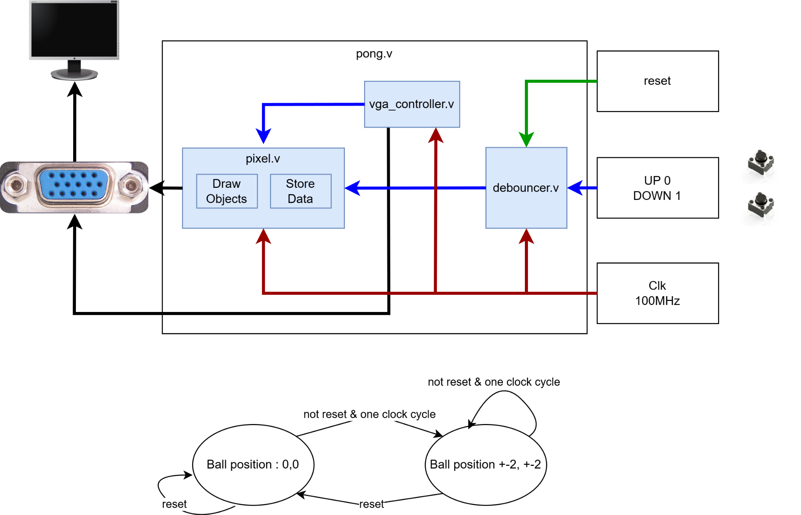
Block Diagram

Slide 6
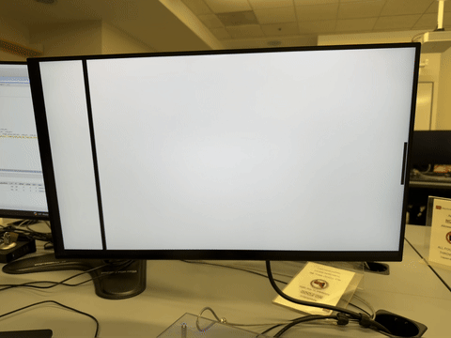
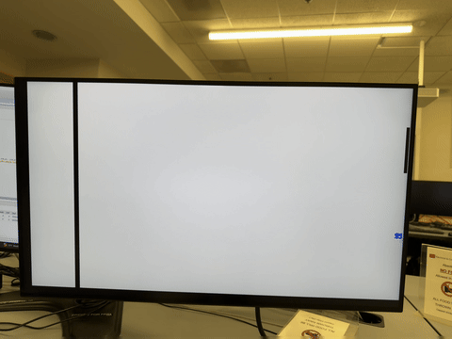
Puck bounces back from objects
Game restarts as the Puck hits the player side wall

Slide 7
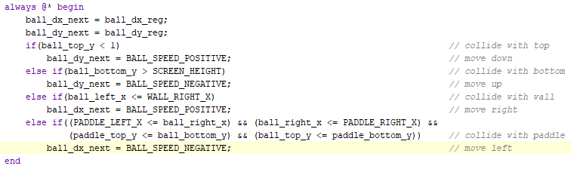
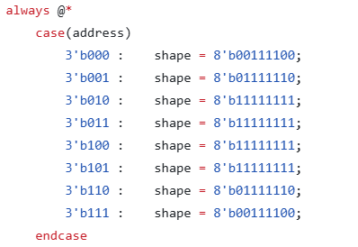
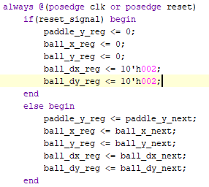
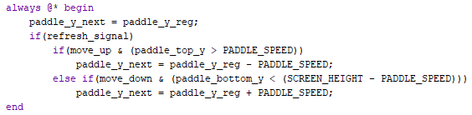
Code Snippets
How the puck bounces back
The projectile shape
How the puck’s position change
How can the player control the paddle

Slide 8
State Diagram - Ball’s Initial Movement
When there’s one clock cycle & reset button not pressed: ball’s position move to the next position.
When the reset button pressed: ball’s position moves to starting position.

Slide 9
Successes
01
04
Render objects on screen
Ball starts from different position & direction (shifting)
02
05
Moving paddle
Ball bounce back from objects
03
06
Moving Puck
When ball touch player side wall, game restarts

Slide 10
Things Still Trying
01
03
Multiplayer
Storing Score in FPGA
02
04
Pause game and show menu to end or restart
Different Difficulty levels

Slide 11
Thank you!
Questions?
Notes:
Explain what design is supposed to do

